Slide 1
Convolutional Neural Networks

Slide 2
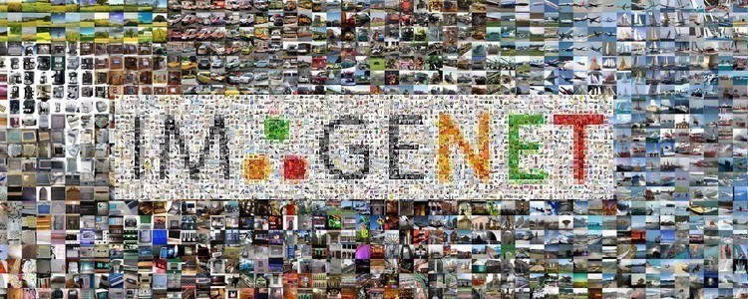
Imagenet
14 million images, 20K categories

Slide 3

Imagenet
https://qz.com/1034972/the-data-that-changed-the-direction-of-ai-research-and-possibly-the-world/

Slide 4
Imagenet
Circa 2006, AI community: “a better algorithm would make better decisions, regardless of the data.”
Fei Fei Li thought: “the best algorithm wouldn’t work well if the data it learned from didn’t reflect the real world”
“We decided we wanted to do something that was completely historically unprecedented,” Li said, referring to a small team who would initially work with her. “We’re going to map out the entire world of objects.

Slide 5
Imagenet
ImageNet: published in 2009 as a research poster stuck in the corner of a Miami Beach conference center, the dataset quickly evolved into an annual competition to see which algorithms could identify objects in the dataset’s images with the lowest error rate.
“The paradigm shift of the ImageNet thinking is that while a lot of people are paying attention to models, let’s pay attention to data,” Li said. “Data will redefine how we think about models.”

Slide 6
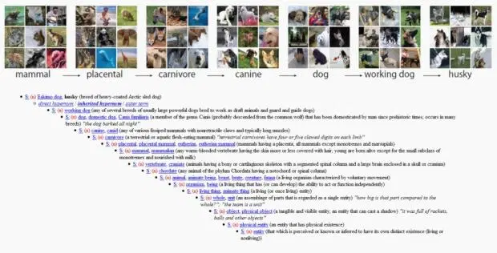
WordNet

Slide 7
WordNet
In the late 1980s, Princeton psychologist George Miller started a project called WordNet, with the aim of building a hierarchical structure for the English language.
For example, within WordNet, the word “dog” would be nested under “canine,” which would be nested under “mammal,” and so on. It was a way to organize language that relied on machine-readable logic, and amassed more than 155,000 indexed words.

Slide 8
Back to Imagenet
Finding the perfect algorithm seemed distant, Li says. She saw that previous datasets didn’t capture how variable the world could be—even just identifying pictures of cats is infinitely complex.
If you only saw five pictures of cats, you’d only have five camera angles, lighting conditions, and maybe variety of cat. But if you’ve seen 500 pictures of cats, there are many more examples to draw commonalities from.
Having read about WordNet’s approach, Li met with professor Christiane Fellbaum, a researcher influential in the continued work on WordNet, during a 2006 visit to Princeton. Fellbaum had the idea that WordNet could have an image associated with each of the words, more as a reference rather than a computer vision dataset.

Slide 9
Back to Imagenet
Li’s first idea was to hire undergraduate students for $10 an hour to manually find images and add them to the dataset. But back-of-the-napkin math quickly made Li realize that at the undergrads’ rate of collecting images it would take 90 years to complete.
Undergrads were time-consuming, algorithms were flawed, and the team didn’t have money—Li said the project failed to win any of the federal grants she applied for, receiving comments on proposals that it was shameful Princeton would research this topic, and that the only strength of proposal was that Li was a woman.
A solution finally surfaced in a chance hallway conversation with a graduate student who asked Li whether she had heard of Amazon Mechanical Turk, a service where hordes of humans sitting at computers around the world would complete small online tasks for pennies.

Slide 10
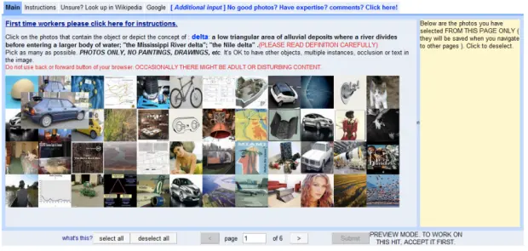
Back to Imagenet

Slide 11
Back to Imagenet
Even after finding Mechanical Turk, the dataset took two and a half years to complete. It consisted of 3.2 million labelled images, separated into 5,247 categories, sorted into 12 subtrees like “mammal,” “vehicle,” and “furniture.”
In 2009, Li and her team published the ImageNet paper with the dataset—to little fanfare. Li recalls that CVPR, a leading conference in computer vision research, only allowed a poster, instead of an oral presentation, and the team handed out ImageNet-branded pens to drum up interest. People were skeptical of the basic idea that more data would help them develop better algorithms.
“There were comments like ‘If you can’t even do one object well, why would you do thousands, or tens of thousands of objects?”

Slide 12
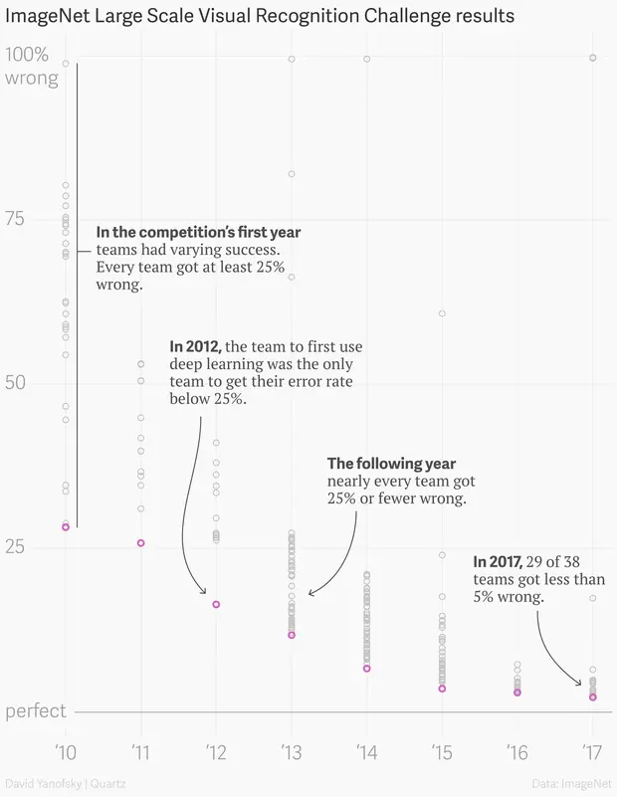
Imagenet
14 million images, 20K categories

Slide 13
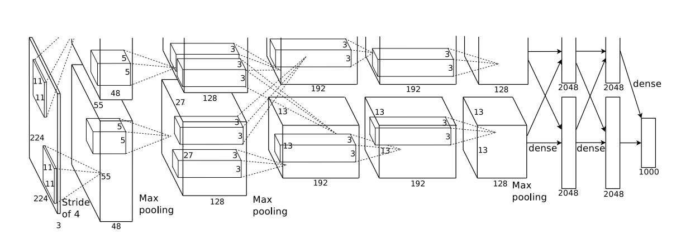
History (AlexNet 2012)

Slide 14
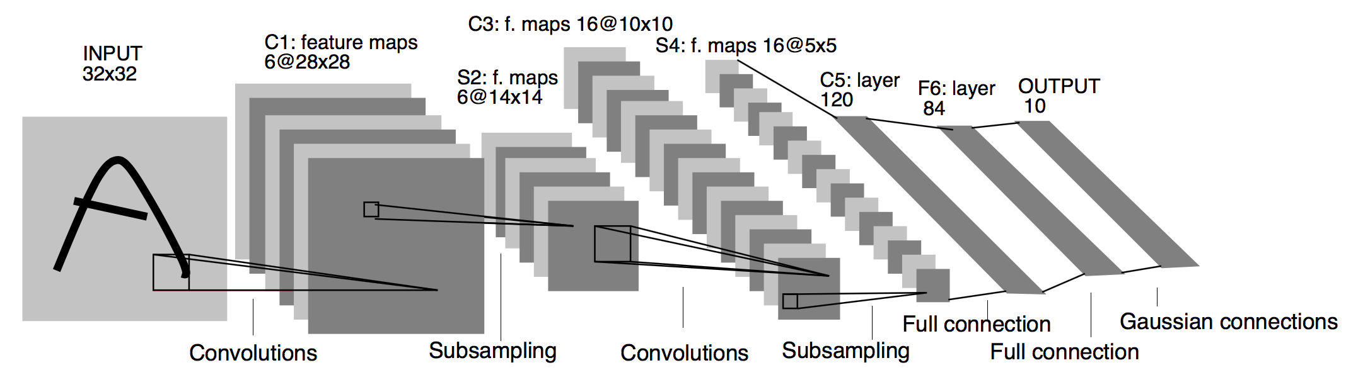
History (LeCun 1998)

Slide 15

Modern day cameras

Slide 16
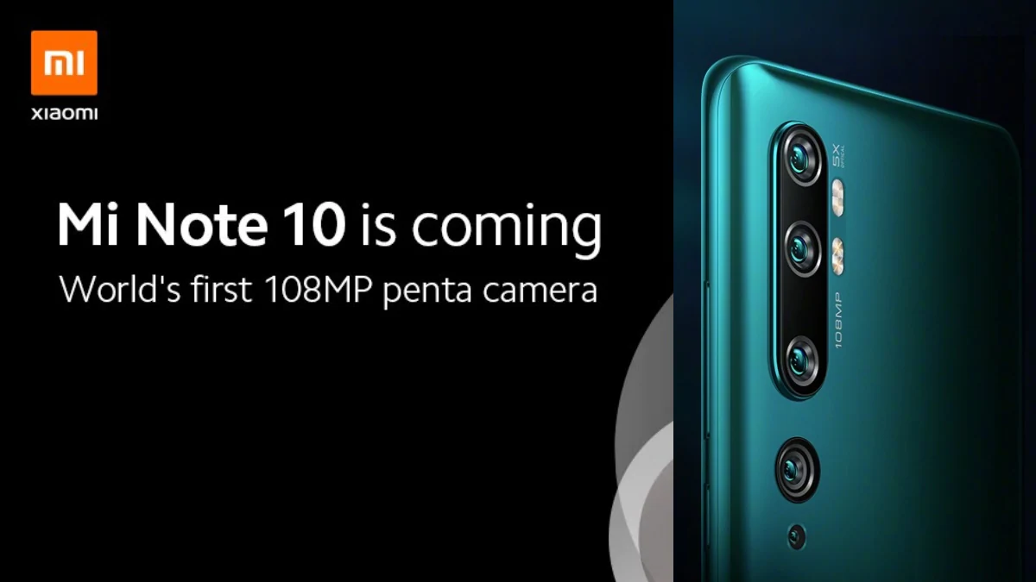
Modern day cameras

Slide 17
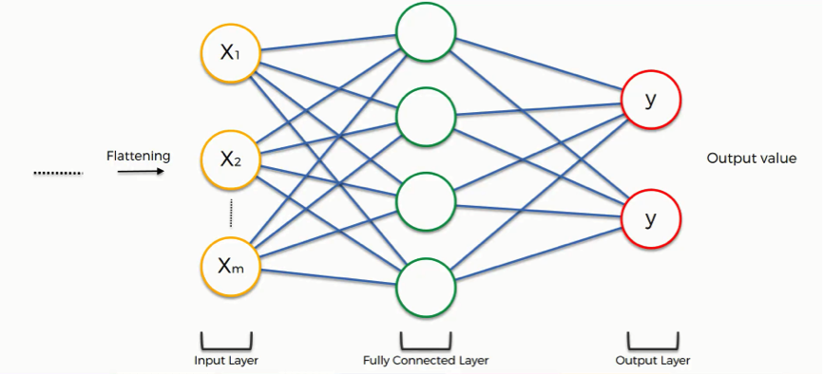
Modern day cameras suitability for MLPs?
Courtesy: https://www.superdatascience.com/convolutional-neural-networks-cnn-step-4-full-connection/

Slide 18
Modern day cameras suitability for MLPs?
If we are classifying cats vs dogs and hidden layer size is 100, what is number of parameters?
Courtesy: https://www.superdatascience.com/convolutional-neural-networks-cnn-step-4-full-connection/

Slide 19
Modern day cameras suitability for MLPs?
If we are classifying cats vs dogs and hidden layer size is 100, what is number of parameters?
N[1] = 100, N[0] = 108*1M*3 (for RGB channel) → Billions of params
Size of weight matrix assuming each param is 32 bytes is 32 bytes*324 billion → several GBs
Courtesy: https://www.superdatascience.com/convolutional-neural-networks-cnn-step-4-full-connection/

Slide 20
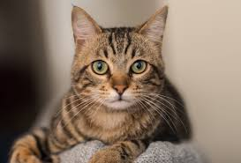
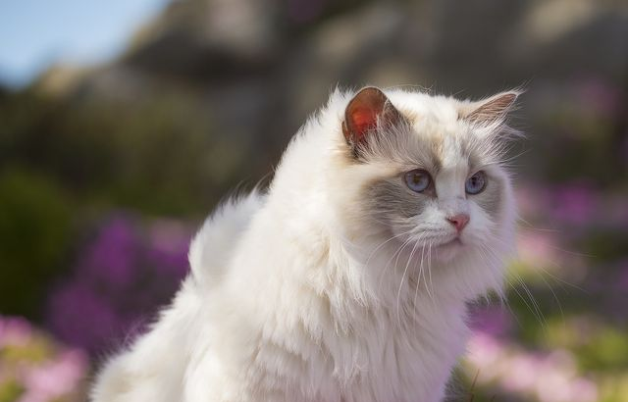
Are MLPs well suited for images?
Courtesy: https://www.rd.com/advice/pets/common-cat-myths/
Courtesy: https://www.goodhousekeeping.com/life/pets/g21525625/why-cats-are-best-pets/
Are both of the above cats?

Slide 21
Are MLPs well suited for images?
Courtesy: https://www.rd.com/advice/pets/common-cat-myths/
Courtesy: https://www.goodhousekeeping.com/life/pets/g21525625/why-cats-are-best-pets/
Assume both are 100X100 images and bounded rectangle are 10X10 pixels

Slide 22
Are MLPs well suited for images?
Courtesy: https://www.rd.com/advice/pets/common-cat-myths/
Courtesy: https://www.goodhousekeeping.com/life/pets/g21525625/why-cats-are-best-pets/
A cat ear is a cat ear, irrespective of the location in the image.
MLP would see these are different input features
Rather, we need “feature detector” that is translation invariant.

Slide 23
Are MLPs well suited for images?
Similar pixel values
Courtesy: https://www.rd.com/advice/pets/common-cat-myths/
Courtesy: https://www.goodhousekeeping.com/life/pets/g21525625/why-cats-are-best-pets/
MLPs assume all input features to be independent
But, we have a spatially local structure, nearby pixels are similar

Slide 24
Key Idea
Ear detector
Eye detector
Face detector
Courtesy: https://www.rd.com/advice/pets/common-cat-myths/
Courtesy: https://www.goodhousekeeping.com/life/pets/g21525625/why-cats-are-best-pets/
Build local feature detectors

Slide 25
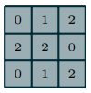
Building Block: Filters and Convolution Operation
(A guide to convolution arithmetic for deep learning)
Filter

Slide 26
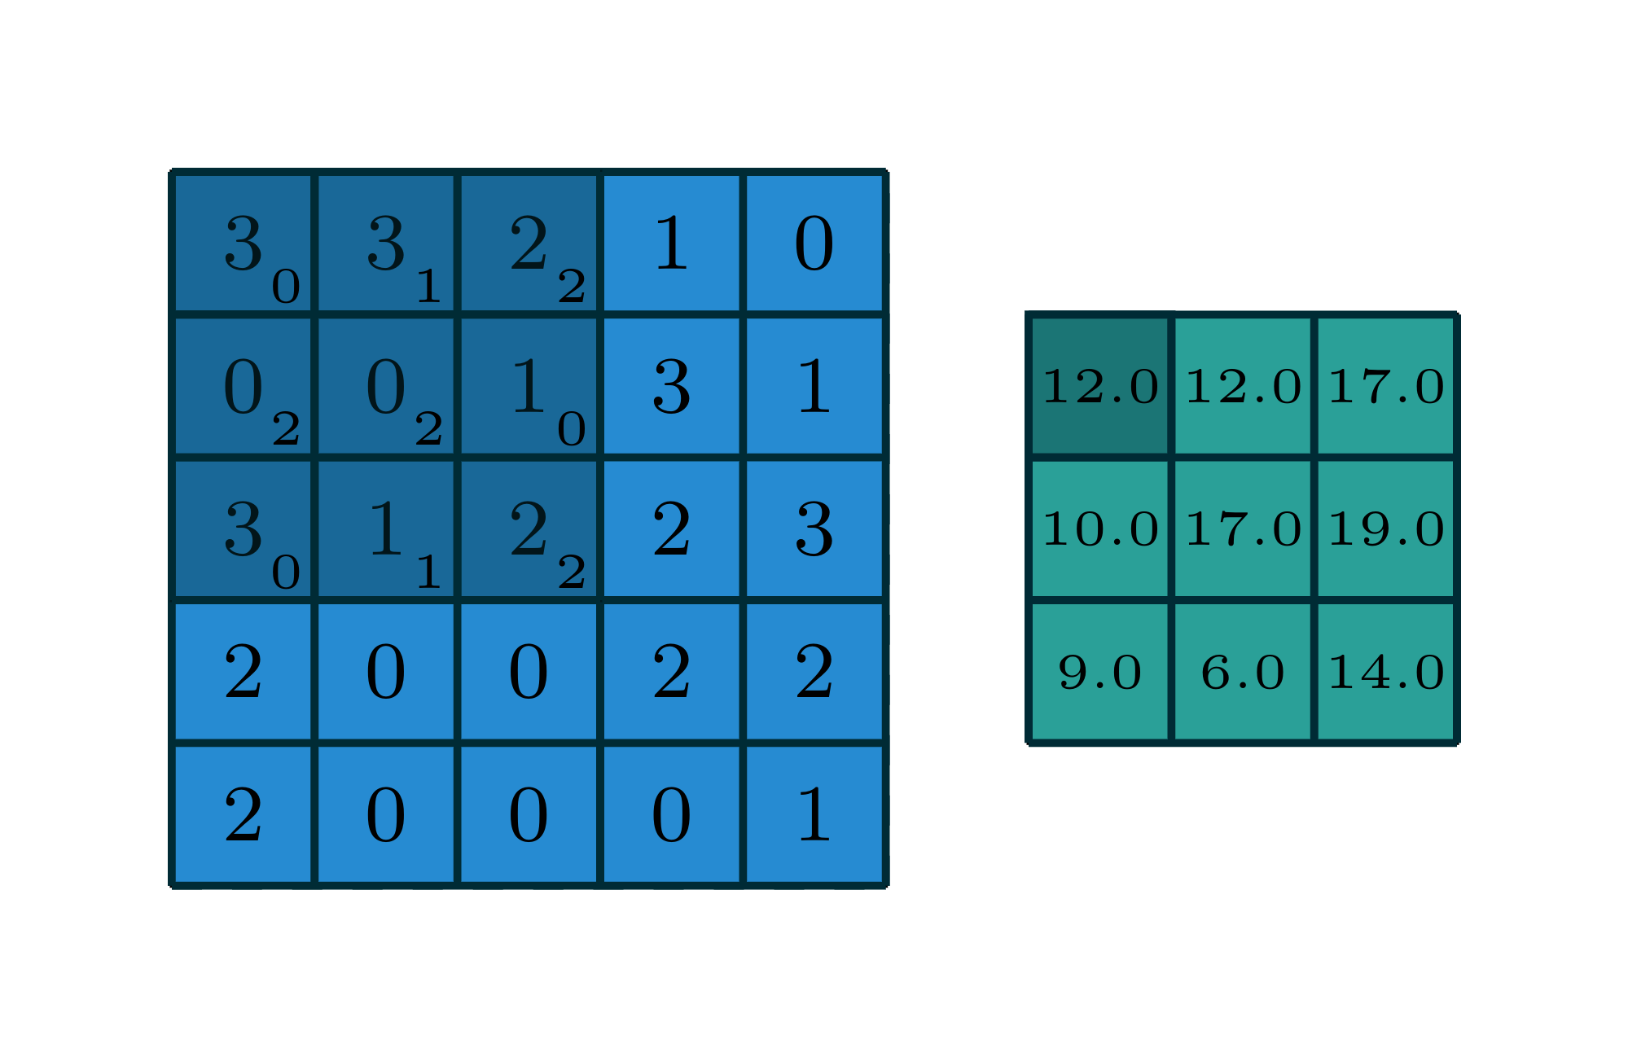
Building Block: Filters and Convolution Operation
(A guide to convolution arithmetic for deep learning)
Input
Output

Slide 27
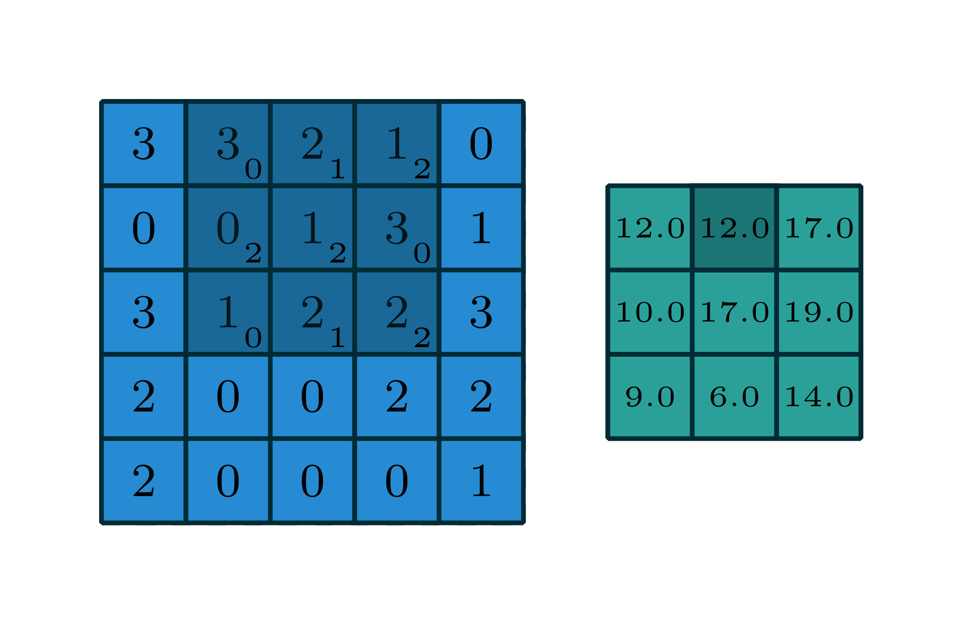
Building Block: Filters and Convolution Operation
(A guide to convolution arithmetic for deep learning)
Input
Output

Slide 28
Building Block: Filters and Convolution Operation
(A guide to convolution arithmetic for deep learning)

Slide 29
Notebook demonstration (edge detection)

Slide 30
Building Block: Filters and Convolution Operation
(A guide to convolution arithmetic for deep learning)
Given input image of n X n and filter of size: f X f, what is the size of the output?

Slide 31
Building Block: Filters and Convolution Operation
(A guide to convolution arithmetic for deep learning)
Given input image of n X n and filter of size: f X f, what is the size of the output?
n-f+1 X n-f+1

Slide 32
Building Block: Filters and Convolution Operation
(A guide to convolution arithmetic for deep learning)
Start with a 32 X 32 image and repeated operations of a single 5 X 5 filter, after how many such operations will we have a 1 X 1 output?

Slide 33
Building Block: Filters and Convolution Operation
(A guide to convolution arithmetic for deep learning)
Start with a 32 X 32 image and repeated operations of a single 5 X 5 filter, after how many such operations will we have a 1 X 1 output?
Iteration | n | f | n-f+1
1 | 32 | 5 | 28
2 | 28 | 5 | 24
3 | 24 | 5 | 20
4 | 20 | 5 | 16
... | ... | ... | ...

Slide 34
Building Block: Filters and Convolution Operation
(A guide to convolution arithmetic for deep learning)
Start with a 32 X 32 image and repeated operations of a single 5 X 5 filter, after how many such operations will we have a 1 X 1 output?
Iteration | n | f | n-f+1
1 | 32 | 5 | 28
2 | 28 | 5 | 24
3 | 24 | 5 | 20
4 | 20 | 5 | 16
... | ... | ... | ...
Problem 1: Can not go very deep with repeated convolution as image size reduces quickly

Slide 35
Building Block: Filters and Convolution Operation
(A guide to convolution arithmetic for deep learning)
How many times is left-most pixel used in a calculation?

Slide 36
Building Block: Filters and Convolution Operation
(A guide to convolution arithmetic for deep learning)
How many times is left-most pixel used in a calculation?
Only once!

Slide 37
Building Block: Filters and Convolution Operation
(A guide to convolution arithmetic for deep learning)
How many times is left-most pixel used in a calculation?
Only once!
How many times is a middle pixel used in a calculation?
Many times. For example, the middle pixel with value 2 used nine times!

Slide 38
Building Block: Filters and Convolution Operation
(A guide to convolution arithmetic for deep learning)
How many times is left-most pixel used in a calculation?
Only once!
How many times is a middle pixel used in a calculation?
Many times. For example, the middle pixel with value 2 used nine times!
Problem 2: The corner pixels are under-utilised

Slide 39
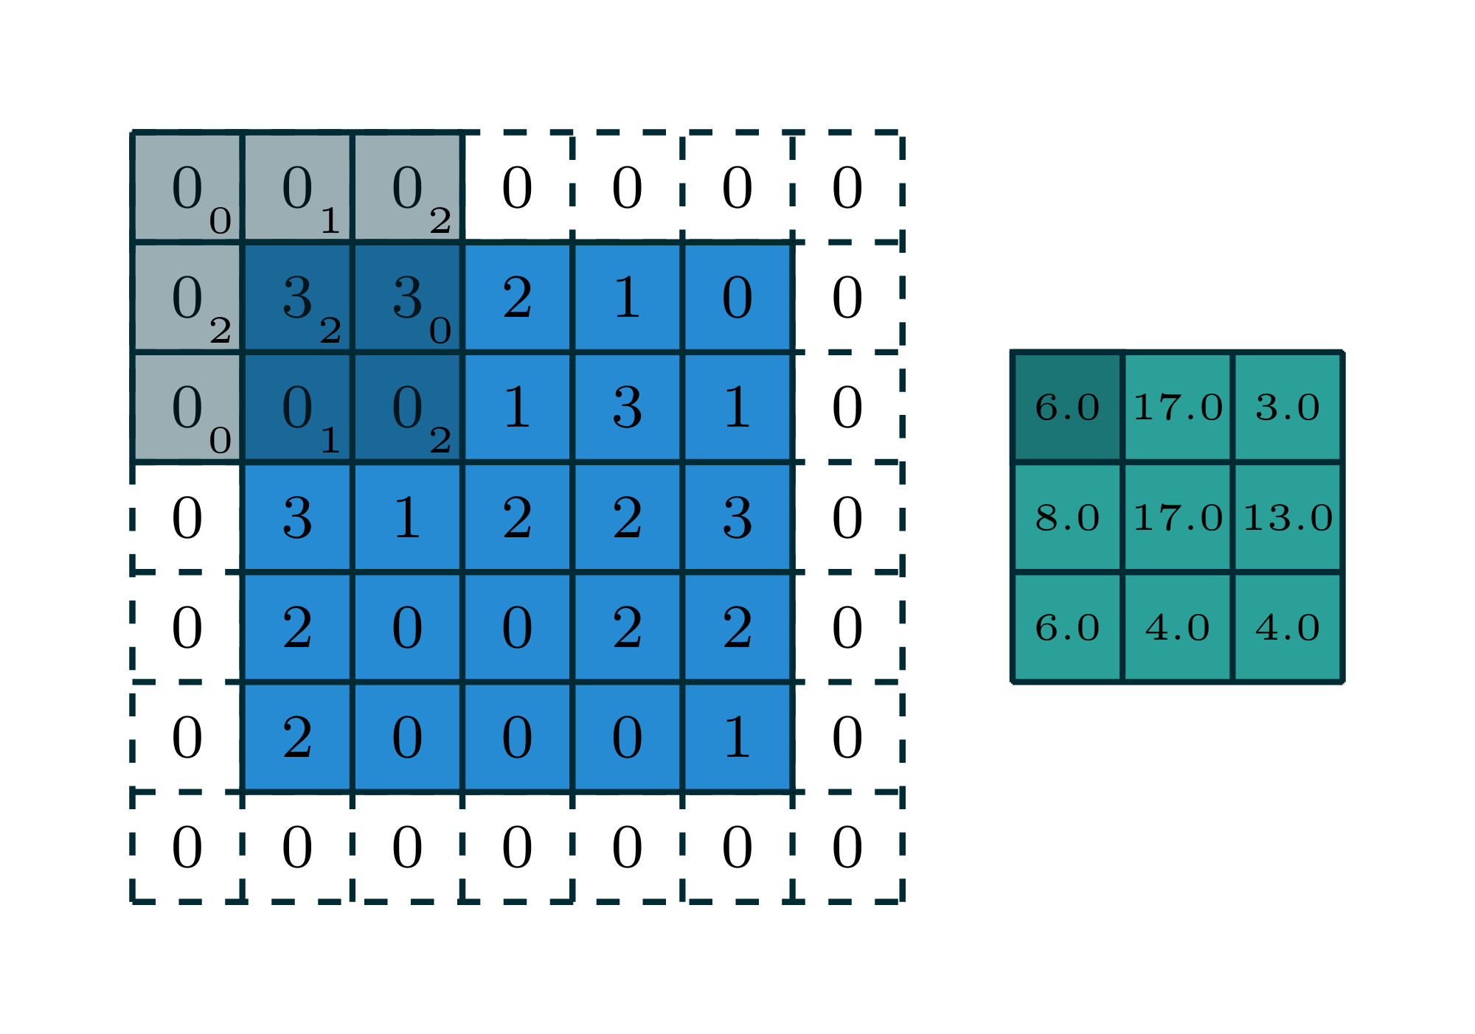
Building Block: Padding
Padded pixels
Input
Output

Slide 40
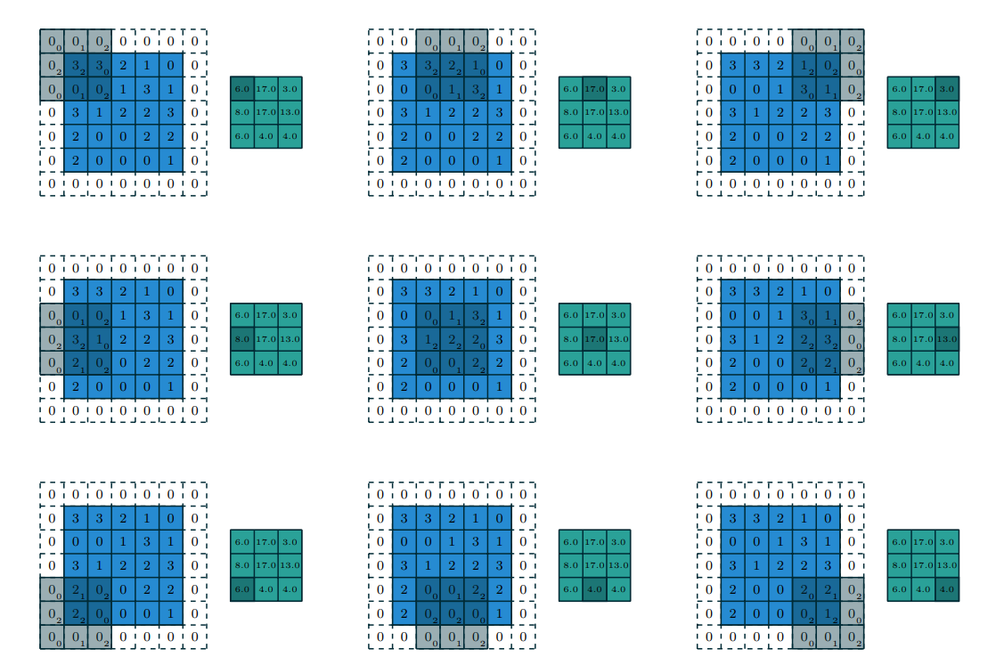
Building Block: Padding

Slide 41
Building Block: Padding
Ques: Given padding of p pixel, n X n image and filter f x f, what is the output size?

Slide 42
Building Block: Padding
Ques: Given padding of p pixel, n X n image and filter f x f, what is the output size?
n+2p-f+1 X n+2p-f+1

Slide 43
Building Block: Padding
Ques: Given padding of p pixel, n X n image and filter f x f, what is the output size?
n+2p-f+1 X n+2p-f+1
Same padding: when n+2p-f+1 = n or,
p = (f-1)/2

Slide 44
Building Block: Strides (subsampling)
Skip every s pixels
Ques: Given p padding, n x n image, f x f filter, s stride, what is output length?

Slide 45
Building Block: Strides (subsampling)
Skip every s pixels
Ques: Given p padding, n x n image, f x f filter, s stride, what is output length?
⌊(n+2p-f)/s⌋ +1 x ⌊(n+2p-f)/s⌋ +1

Slide 46

Building Block: Pooling (subsampling)
Max pooling
Similar to filter and convolution operation, but, gives the max value in the f x f as the output

Slide 47
Building Block: Pooling (subsampling)
Max pooling
Similar to filter and convolution operation, but, gives the max value in the f x f as the output
Works well in practice
Reduces representation size

Slide 48

Building Block: Pooling (subsampling)
Average pooling
Similar to filter and convolution operation, but, gives the average value in the f x f as the output
Works well in practice
Reduces representation size

Slide 49
Building Block: Multiple channels
Input: n x n x c image

Slide 50
Building Block: Multiple channels
Input: n x n x c image
Filter for r channel: f x f

Slide 51
Building Block: Multiple channels
Input: n x n x c image
Filter for r channel: f x f
Output for r channel: n-f+1 x n-f+1

Slide 52
Building Block: Multiple channels
Input: n x n x c image
Filter for g channel: f x f
Output for g channel: n-f+1 x n-f+1

Slide 53
Building Block: Multiple channels
Input: n x n x c image
Filter for b channel: f x f
Output for b channel: n-f+1 x n-f+1

Slide 54
Building Block: Multiple channels
Input: n x n x c image
Filter for 3 channel: f x f X 3
Output for 3 channel: n-f+1 x n-f+1 X 1

Slide 55
Building Block: Non-linearity
g( +b)
Input: n x n x c image
Filter for 3 channel: f x f X 3
Activation Output for 3 channel: n-f+1 x n-f+1 X 1

Slide 56
Exercise LeNet-5

Slide 57
Exercise LeNet-5
Q1: What is input size?

Slide 58
Exercise LeNet-5
Q1: What is input size?
32X32X1 (grayscale)

Slide 59
Exercise LeNet-5
Q2: What is filter size for first layer (assume no padding)

Slide 60
Exercise LeNet-5
Q2: What is filter size for first layer (assume no padding, 1 stride)
5X5: 32 → 32 - 5 +1 =28

Slide 61
Exercise LeNet-5
Q3: What is number of filters used in first layer?

Slide 62
Exercise LeNet-5
Q3: What is number of filters used in first layer?
6

Slide 63
Exercise LeNet-5
Q4: What is size of pool filter?

Slide 64
Exercise LeNet-5
Q4: What is size of pool filter?
f=2, s=2 (stride 2)

Slide 65
Exercise LeNet-5
Q5: What is size of filter for this layer convolution?

Slide 66
Exercise LeNet-5
Q5: What is size and number of filter for this layer convolution?
16 filter 5X5 size with stride 1

Slide 67
Exercise LeNet-5
Q6: What is size of this pool layer?

Slide 68
Exercise LeNet-5
Q6: What is size of this pool layer?
f=2, s=2

Slide 69
Exercise LeNet-5
Q7: This layer is connected to an MLP like layer, how?

Slide 70
Exercise LeNet-5
Q7: This layer is connected to an MLP like layer, how?
We flatten 16X5X5 to create a 400X1 matrix

Slide 71
Exercise LeNet-5
Softmax for 10 outputs
Input
-------CONV1-----------------
-------CONV2--------------
FC3
FC4
FC5

Slide 72
Exercise LeNet-5
What is the total number of parameters?
Softmax for 10 outputs
Input
-------CONV1-----------------
-------CONV2--------------
FC3
FC4
FC5

Slide 73
Exercise LeNet-5
What is the total number of parameters?
CONV1: 6 filters of size 5 X5X1(channel) = (6*5*5) + 6 biases = 156
POOL1: No params
CONV2: 16 filters of size 5 X 5X6(six channels) = (16*5*5*6) + 16 biases = 2416
FC1: Weight matrix of size 120 X 400 + 120 biases = 48120
FC2: Weight matrix of size 84 X 120 + 84 biases = 10164
FC3: Weight matrix of size 10 X 84 + 10 biases = 850
Total = 61,706

Slide 74
Notebook: LeNet-5, AlexNet, VGG-16
Notebook

Slide 75
Training CNNs for own applications
Train fully from scratch
Transfer learning -- store activations

Slide 76
Visualising CNNs
t-SNE or PCA on last hidden layer … MNIST
Same exercise on Imagenet? ..

